Slide 1
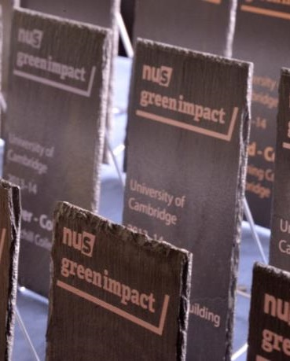
Green Impact at the University of Cambridge This year’s stats…
24 Bronze, Silver, and Gold teams.
9 College teams taking part in Colleges workbook.
5 Labs teams and 5 ‘Excellence’ projects
Average of 62 actions per team
2,174 actions in total (532 more than last year!)
1,843 staff members engaged by workbook actions.

Slide 2
Participation in Green Impact at the University of Cambridge
2,174 actions
1,684 actions
1,642 actions
611 actions

Slide 3
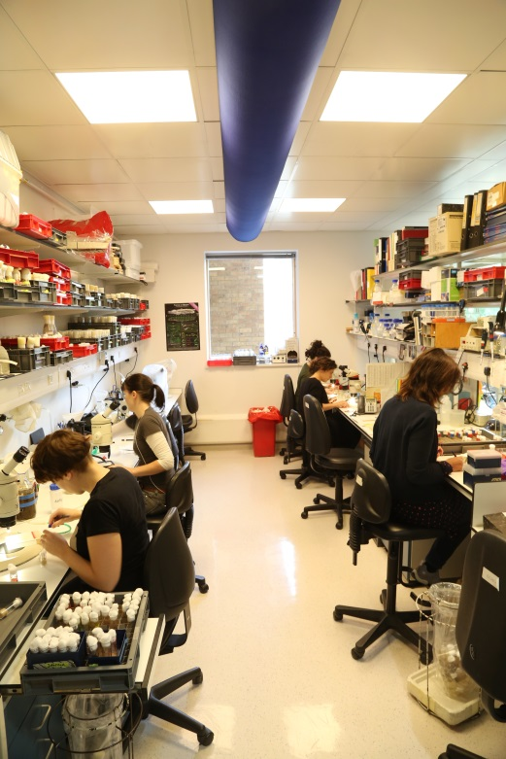
Green Impact at the University of Cambridge This year’s top teams!
Top Labs Teams:
314 points MRC Epidemiology Labs
274 points IMS-MRL
250 points Geography Science Labs
190 points Obs & Gynae Green Team
173 points Plants Sciences Green Team
6 teams with 20 actions (minimum for Bronze award)

Slide 4
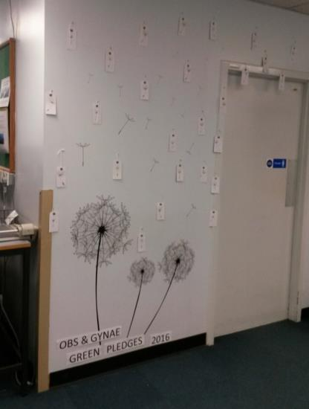
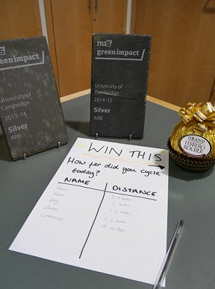
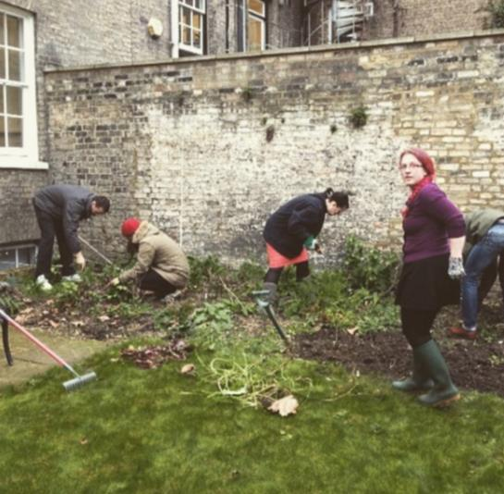
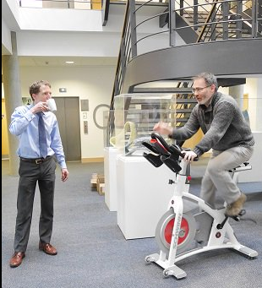
Green Impact at the University of Cambridge What’s been happening?
CISL staff garden
Obs & Gynae dept pledge wall
POLIS bike event

Slide 5
Green Impact at the University of Cambridge Quotes from the auditors:
Registrary Offices: ‘The Registrary Offices have done a wonderful job on the Green Impact scheme! The hard work is apparent, the green newsletter is very well made and has been a good way for the department to meet the Green Impact goals’
Corpus Christi ‘were eager to get both staff and students involved in the green impact scheme and were doing great work fulfilling the targets across a range of sectors’
IMS-MRL ‘It’s a considerable effort to have achieved what they have done’

Slide 6
Green Impact at the University of Cambridge This year’s top teams!
Top College Teams:
1) 368 points Clare College
2) 341 points Downing College
3) 321 points Corpus Christi College
4) 257 points St Catharine’s College
5) 253 points Robinson College

Slide 7
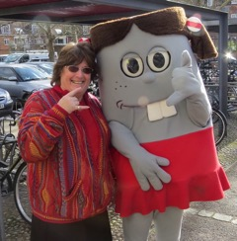
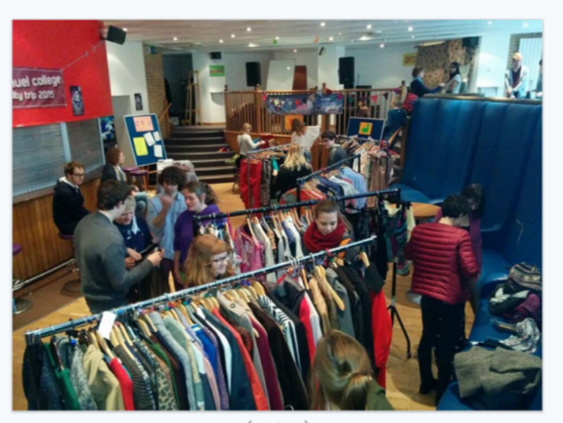
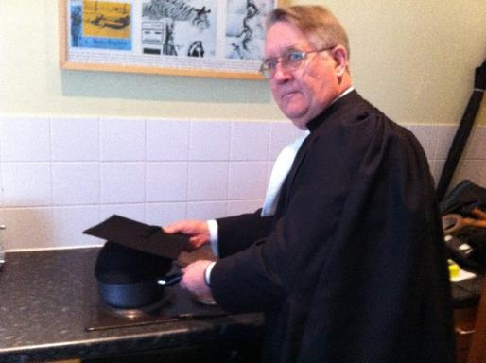
Green Impact at the University of Cambridge What’s been happening?
‘Leap into a jumper’ and ‘Miss Positive’ at MML!
Swap shop/fashion fair at Emmanuel
An academic approach to saving energy at Downing College!

Slide 8
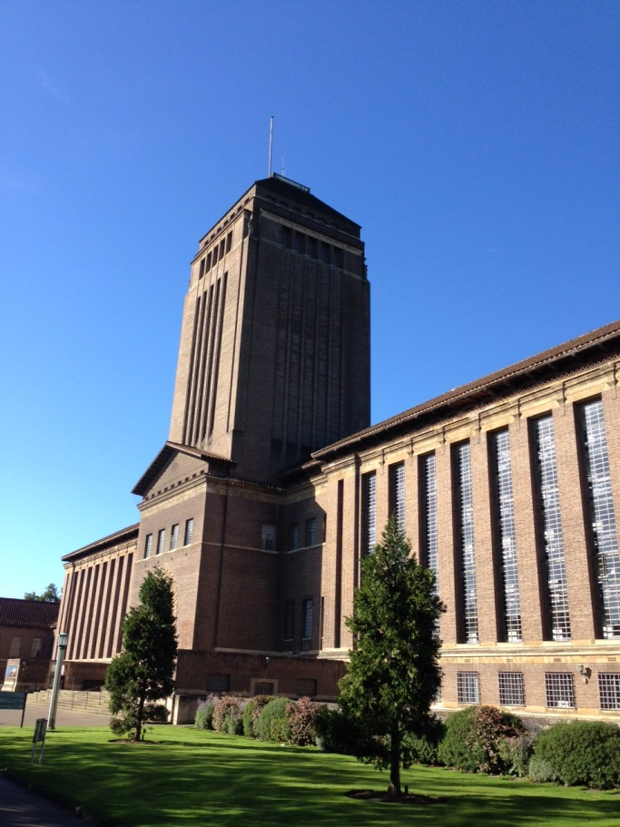
Green Impact at the University of Cambridge This year’s top teams!
Top Gold Teams:
231 points Green Futures Group (UL)
213 points MRC Epidemiology Labs
184 points Dept of Land Economy
178 points Modern & Med. Languages
169 points Alison Richards Building

Slide 9
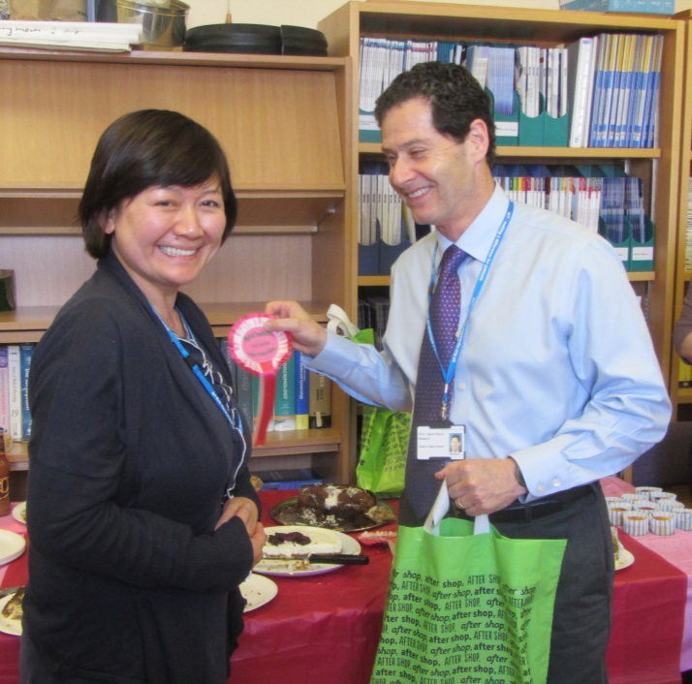
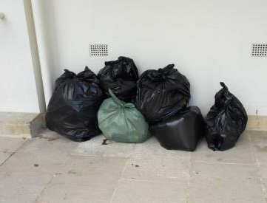
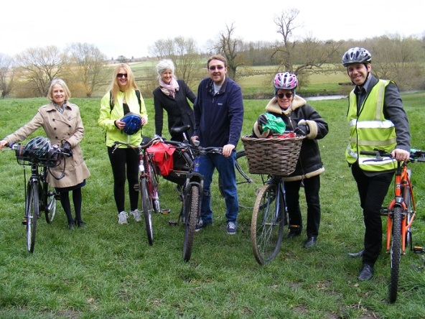
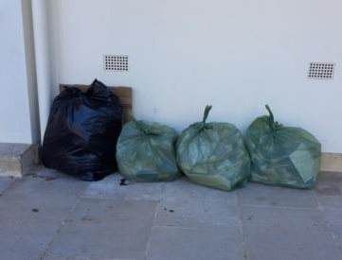
Green Impact at the University of Cambridge What’s been happening?
University Library bike trip to Grantchester for Spotlight on Travel month
Head of Dept at Pediatrics presents staff member with prize at Green impact event
Clare College recycling intervention – before and after!

Slide 10
Green Impact at the University of Cambridge Quotes from the auditors:
MRC Epidemiology ‘this team was genuinely impressive in terms of the commitment and the amount of time and effort they clearly put into this project’
Modern & Mediaeval Languages: ‘We are really impressed that after sorting out the environmental performance of the building, you are now looking into structural changes to further Green Impact. You have clearly inspired us to introduce initiatives such as the ‘bike and bake’, ‘academic of the year’, duplex printing and the suggestion box in our own departments!”

Slide 11
Green Impact at the University of Cambridge This year’s top teams!
Top new teams this year:
173 points Geography Science Labs
2) 154 points Emmanuel College
3) 130 points Registrary Offices
4) 111 points Clare Hall

Slide 12
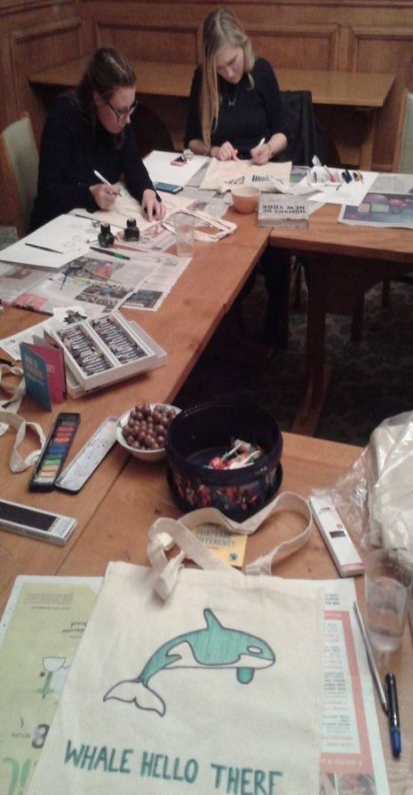
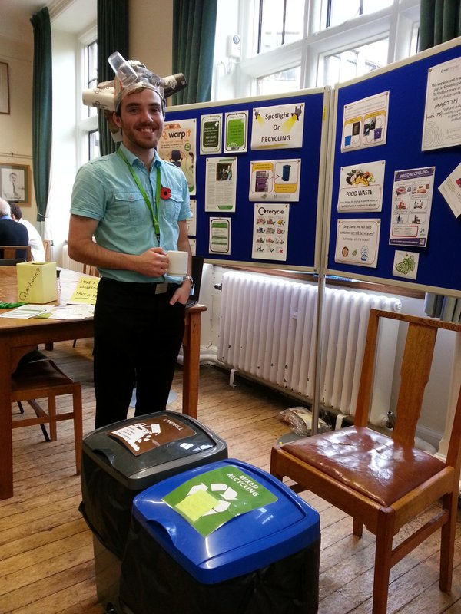
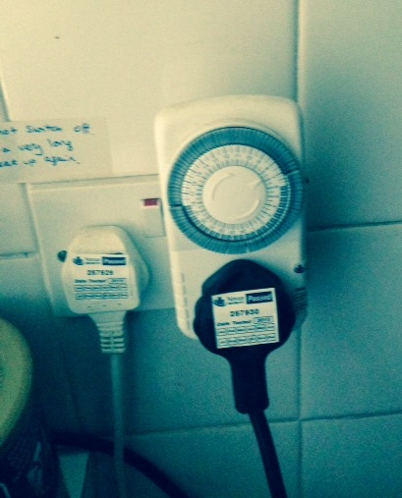
Green Impact at the University of Cambridge What’s been happening?
Tea room boiler auto-timer at Clare College
Fairtrade-Art Society Collaboration at St Catherine’s College
Spotlight on recycling event at Plant Sciences

Slide 13
Green Impact at the University of Cambridge Quotes from the auditors:
Geography: ‘It was nice to see the Green Impact scheme really take root in this first year in the department. The team is clearly enthusiastic and it's nice to see members from every section of the department working together with one goal.’
Psychology: ‘They were particularly enthusiastic, and there were many visible signs about energy efficiency and recycling initiatives everywhere!’
Cambridge Commonwealth Trusts: ‘The green team seemed very proud and invested in what the whole staff team was doing, and rightly so!’

Slide 14
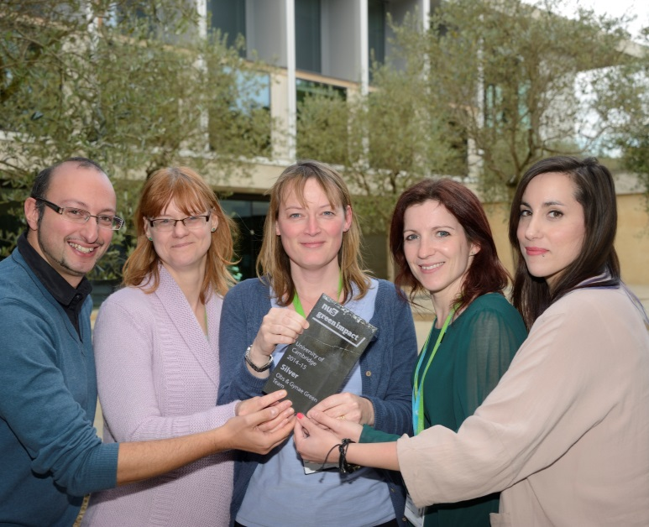
Green Impact at the University of Cambridge This year’s top teams!
Most points gained compared to last year:
328 points – Obs & Gynae dept.
324 points – Plant Sciences
244 points – MRC Epidemiology
236 points – Pembroke College
220 points – Green Futures Group

Slide 15
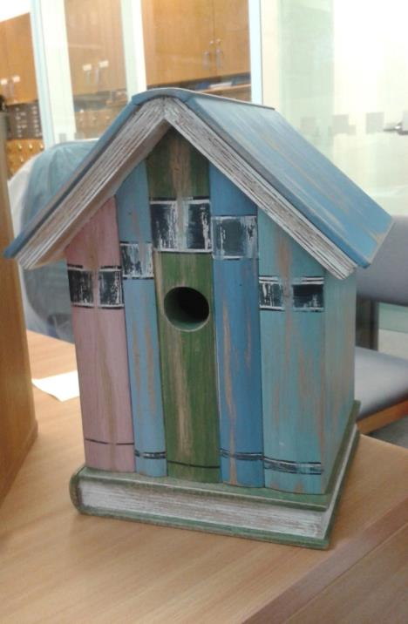
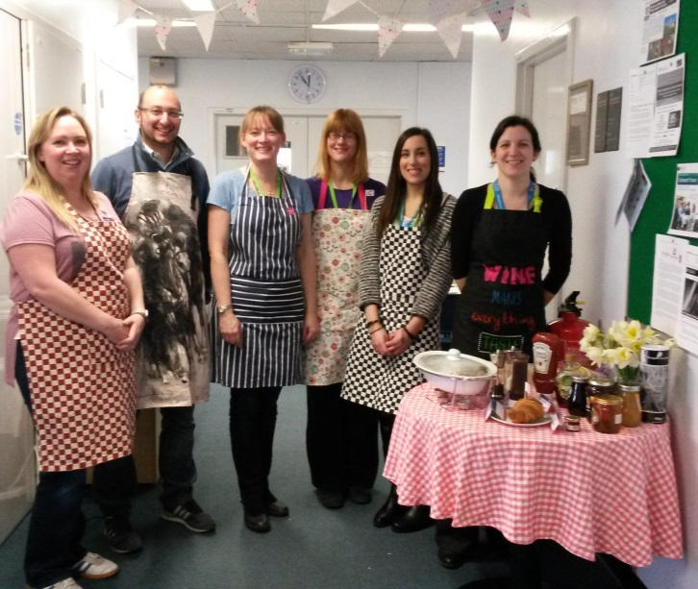
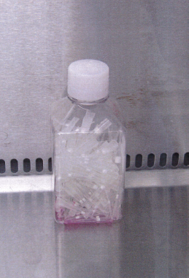
Green Impact at the University of Cambridge What’s been happening?
Obs & Gynae fairtrade breakfast
Recycling plastic media bottles as pipette tip buckets at IMS-MRL
University Library bird boxes

Slide 16
Green Impact at the University of Cambridge Quotes from the auditors:
Downing College: ‘We were impressed by the commitment to sustainability at Downing College – the planning is incredible, from the public pathway to the underground heat pump, and they definitely deserve the Gold award!’
Greenwich House ‘the pace of work was impressive with fortnightly meetings, and it was great to see several specific initiatives embedded in the building (for instance the PIR sensors and electric car charging) and that staff were involved (for instance the fact that bins are well labelled, the pen recycling, as well as the booklets, maps and mugs available to staff)’

Slide 17
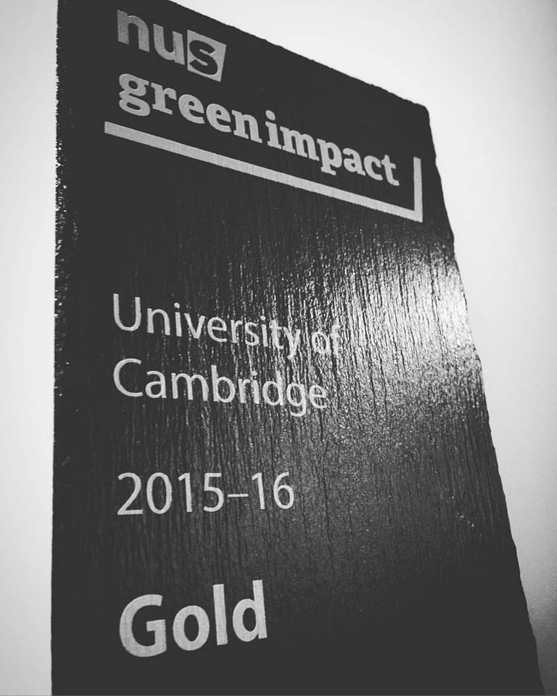
Green Impact at the University of Cambridge This year’s top teams!
Top teams overall:
1) 700 points MRC Epidemiology Labs
2) 500 points Obs & Gynae dept
3) 495 points Plants Sciences
4) 459 points IMS-MRL
5) 399 points Green Futures Group

Slide 18
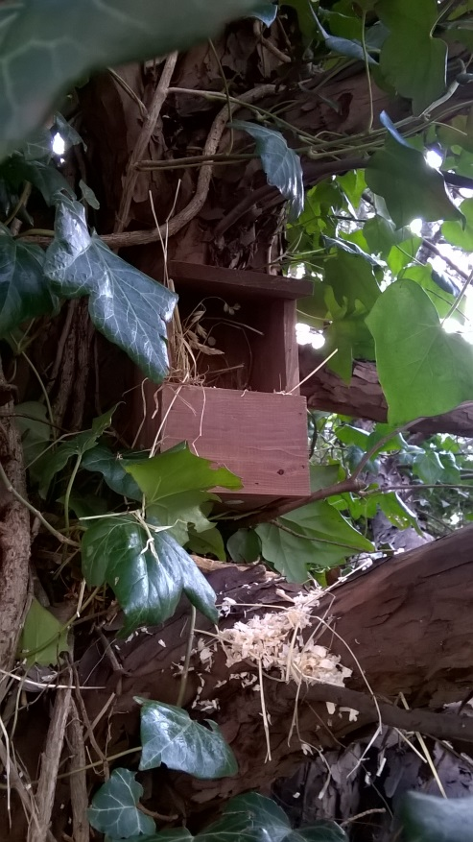
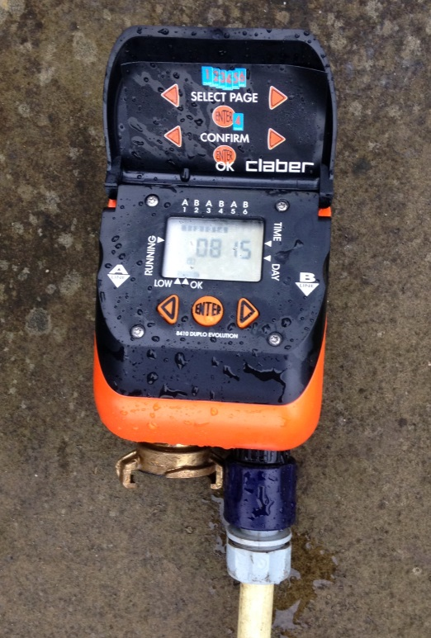
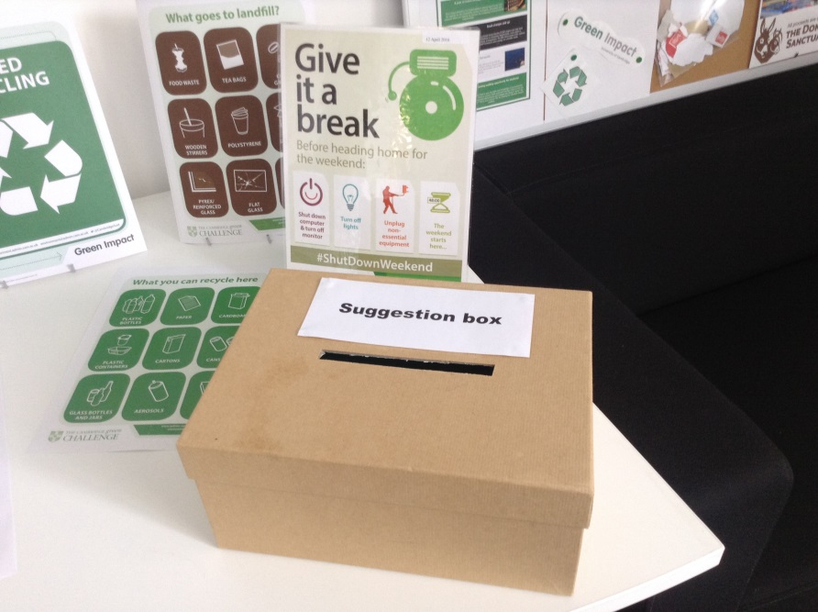
Green Impact at the University of Cambridge What’s been happening?
Green suggestion box at Greenwich House
Bird box installed in Counselling Service garden
Botanic Gardens water timer

Slide 19
Green Impact at the University of Cambridge Quotes from the auditors:
The Disability Resource Centre ‘are a really friendly, close-knit team who clearly care a lot about the Green impact scheme. The changes were so visible everywhere around the office; it was so clearly a part of everyday life in the community there’.
Counselling service: ‘The team seemed really enthusiastic and willing to try to solve any problems that came up, they seemed to be working really well as a team and they got everyone in the service involved in green impact!’
Psychiatry: ‘the whole department had enthusiastically taken on board the sustainability initiatives, everyone was very receptive to the audits and very happy to help’

